Slide 1
ESC201 : Introduction to Electronics
Solution: Question Set # 6
Solution Credit: B. Mazhari, A. Gupta,
I. Mondal

Slide 2
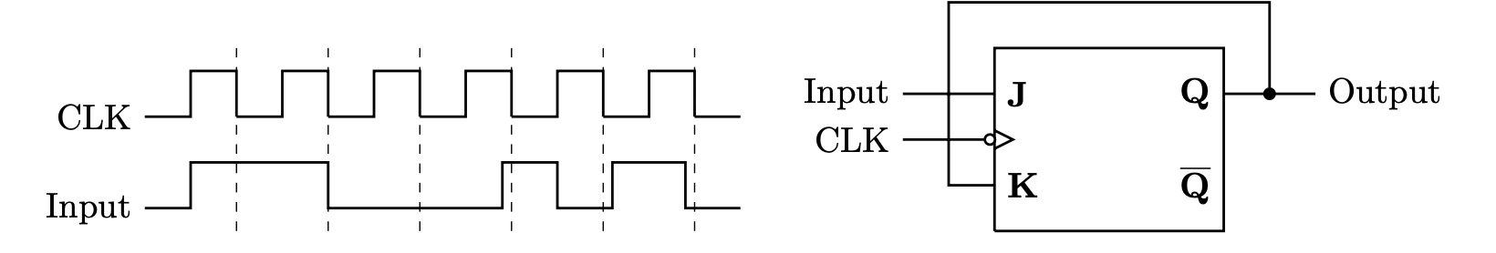
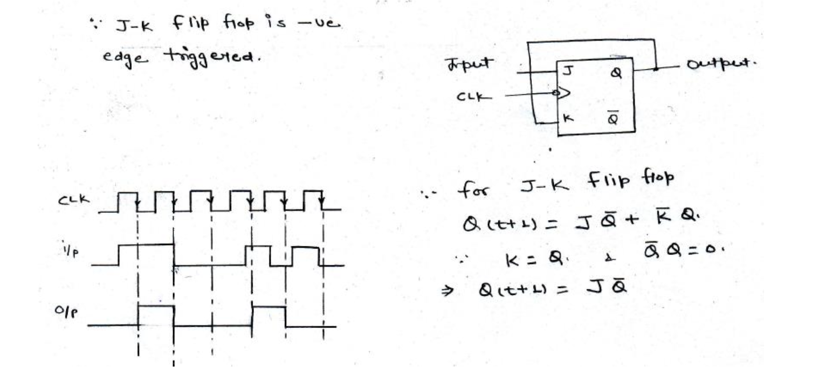
1. The waveform of the clock as shown below excites the circuit shown. Sketch the output waveform.

Slide 3
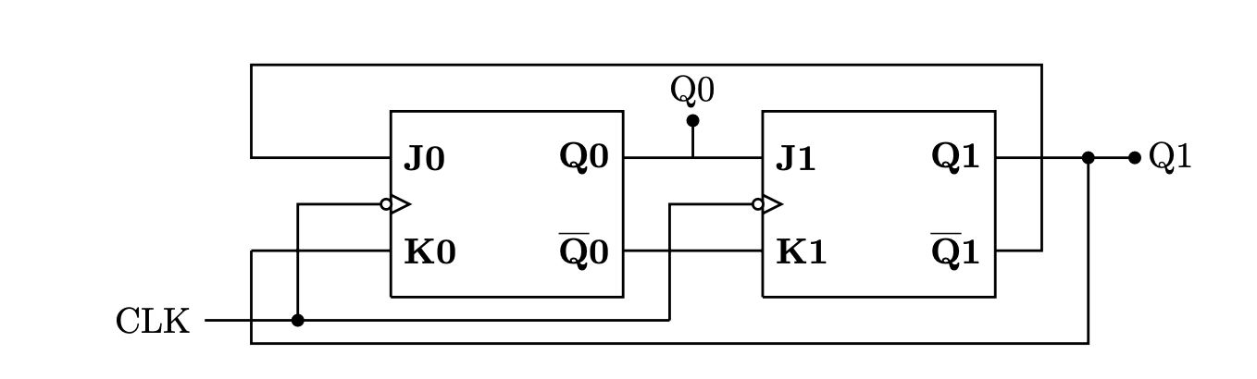
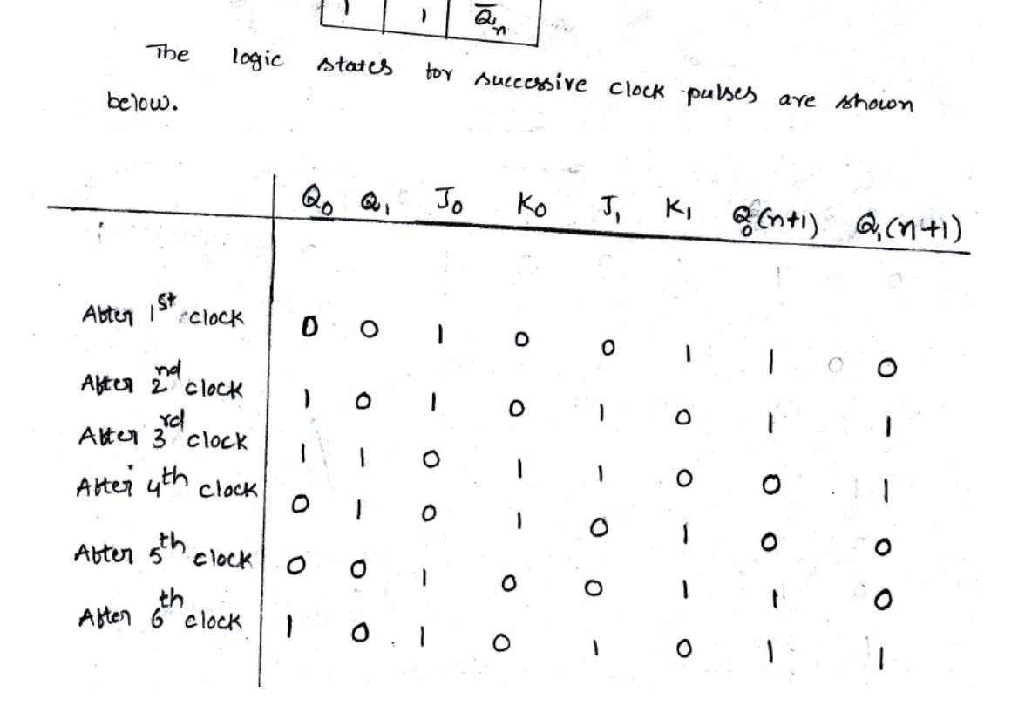
2. If initially Q0 = Q1 = 0, find the logic states of Q0 and Q1 immediately after 777th clock pulse.

Slide 4
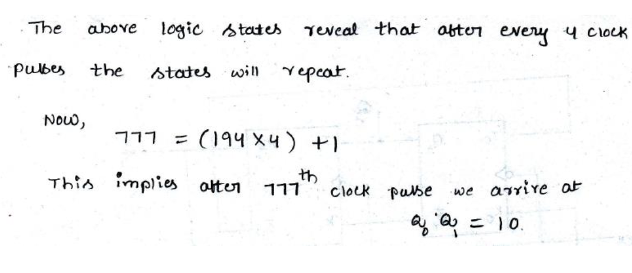

Slide 5
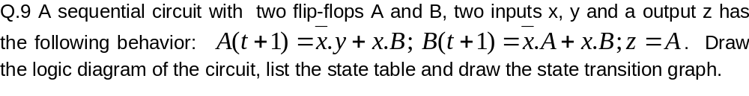
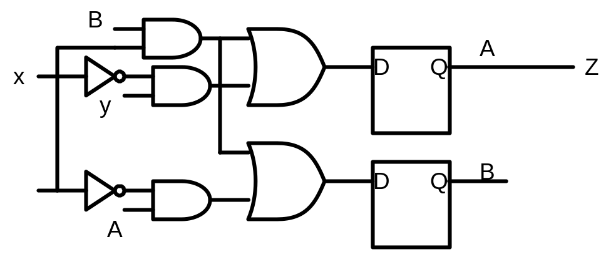


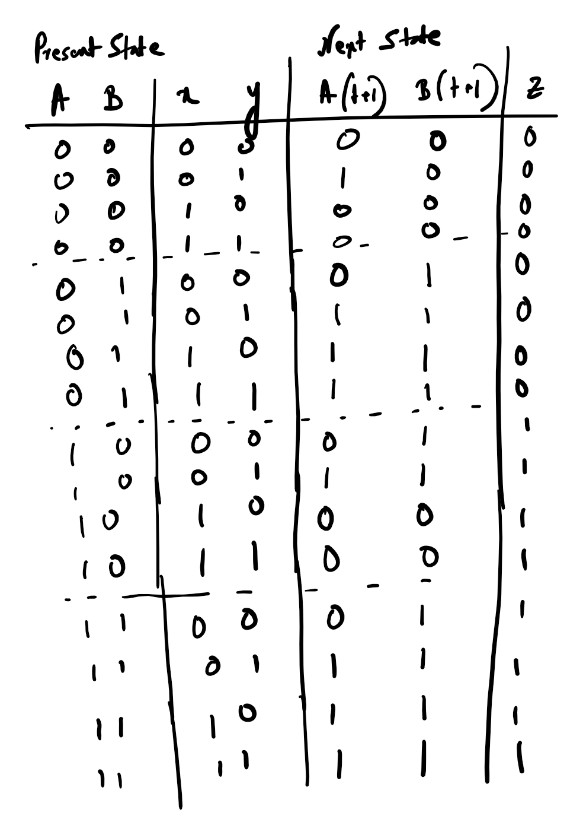
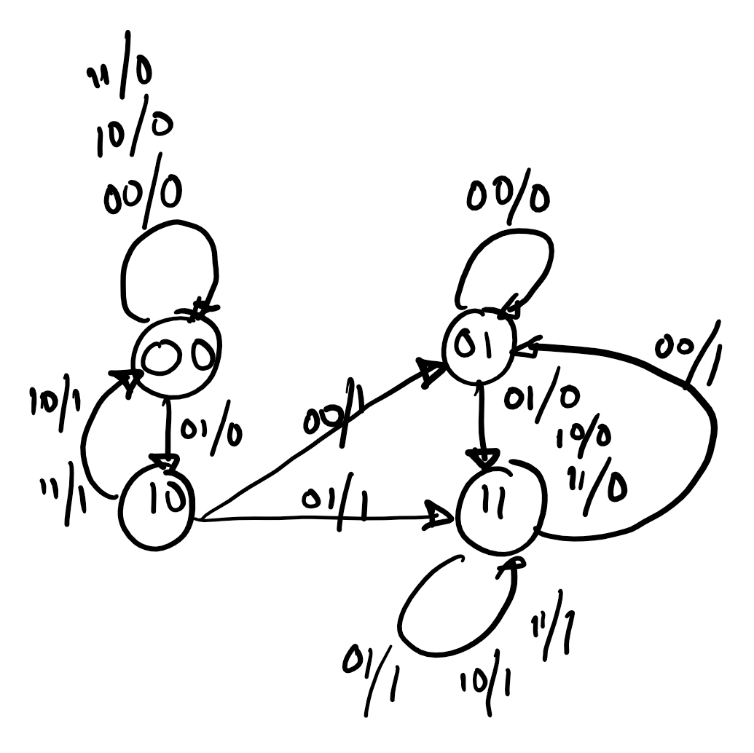

Slide 6
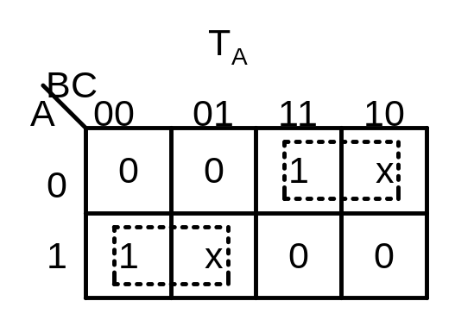
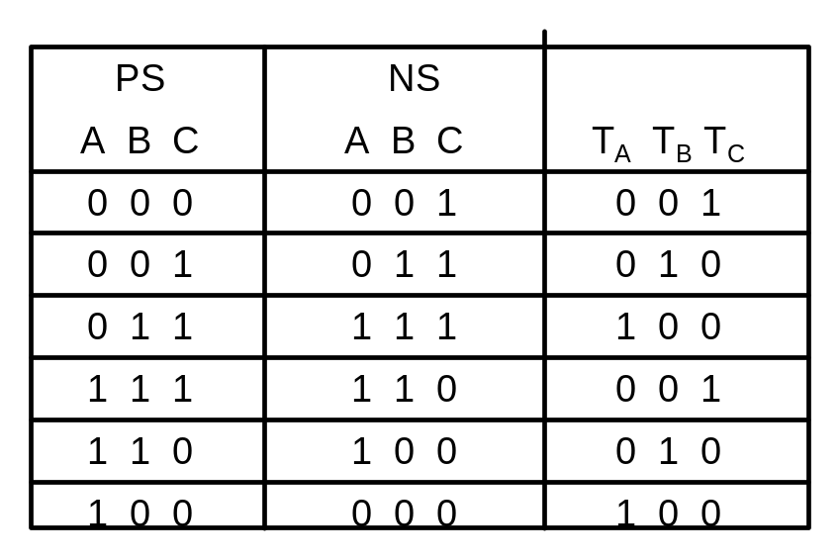

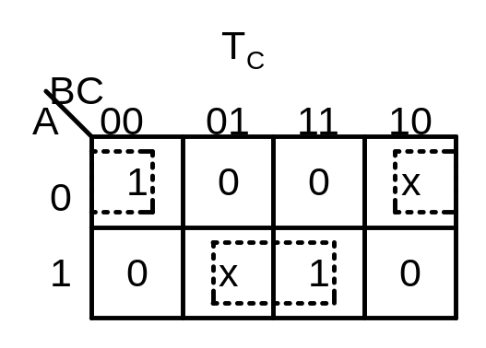
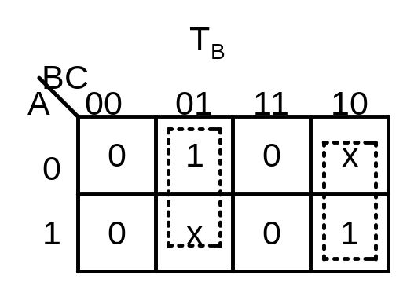


Q.4 Design a synchronous counter using T flip-flops that goes through the following repeating sequence 0, 1,3,7,6,4. Take the unused states as don’t care states. Check if the circuit corrects itself if by chance it happens to go to one of the unused states. If not, correct the problem

Slide 7
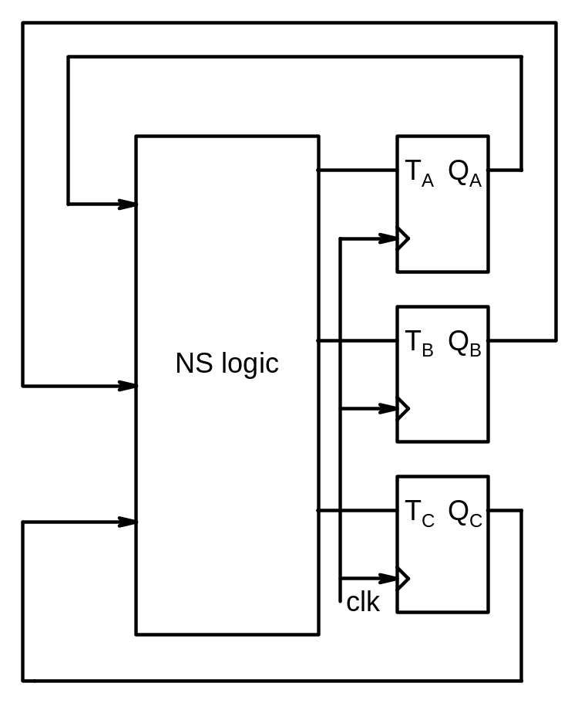
Unused states are ABC = 010 and 101
For 010, TA = 1, TB = 1, TC = 1 so the next state is 101 which is an unused state as well
For ABC = 101 state: TA = TB=TC = 1 so the next state will be 010 which is unused state. Thus we see that if the counter goes into one of the unused states, it will not be able to recover to a proper used state.

Slide 8
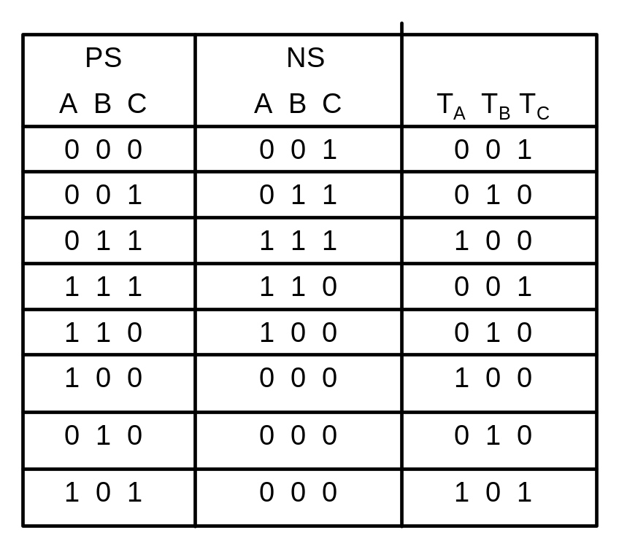
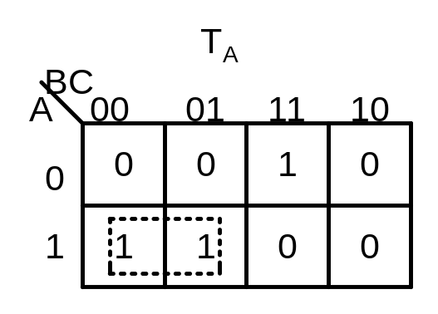

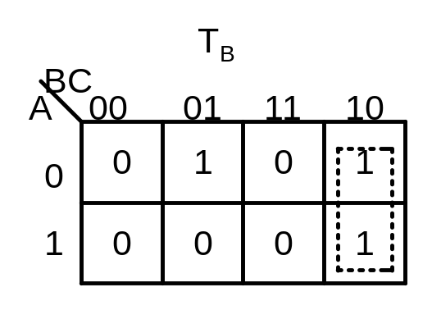

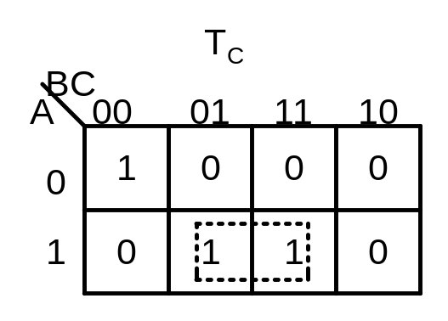

A way to avoid this problem is to modify the transition table so that if the counter goes to a unused state, it then transitions to a used state say 000.
Note that the Boolean expressions and thus the combinational logic has become more complex.

Slide 9
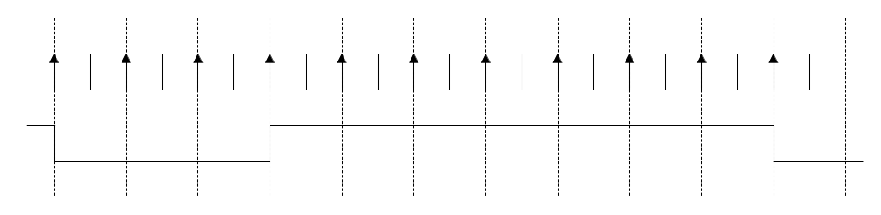
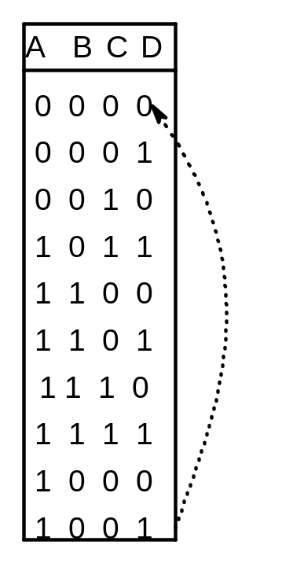
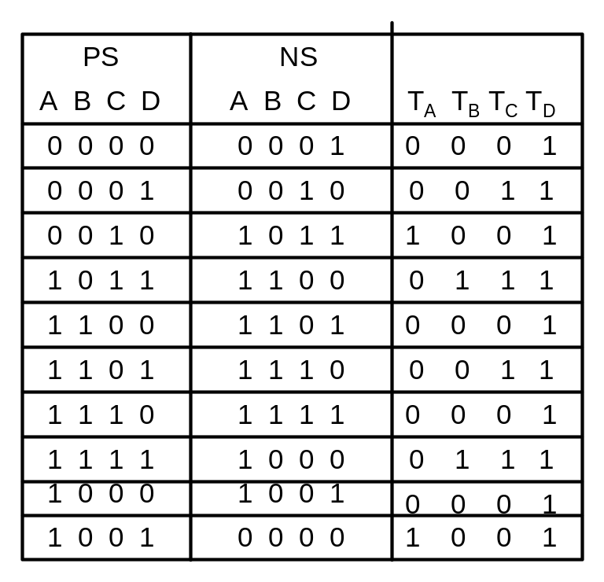

Q.5 From a frequency of 10KHz, generate a signal of frequency 1KHz having the following waveform
We need a divide by 10 counter so 4 FFs are required. A possible state transition of the counter:
Note that FF A output will have the required waveform.

Slide 10
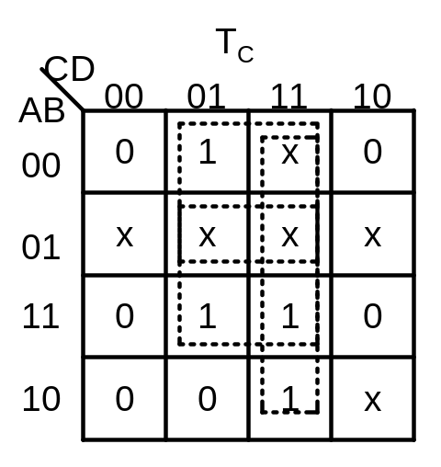
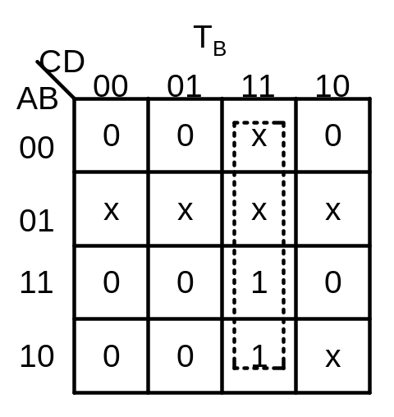


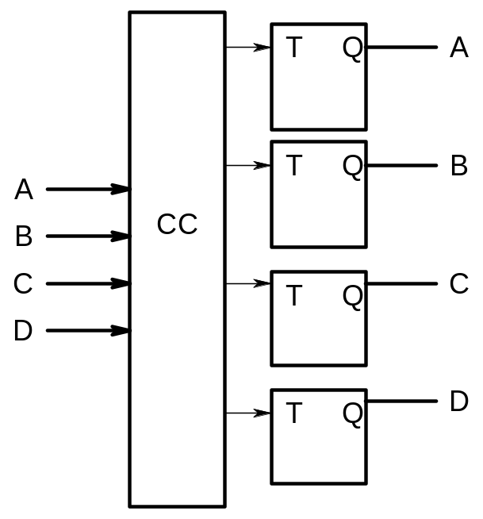
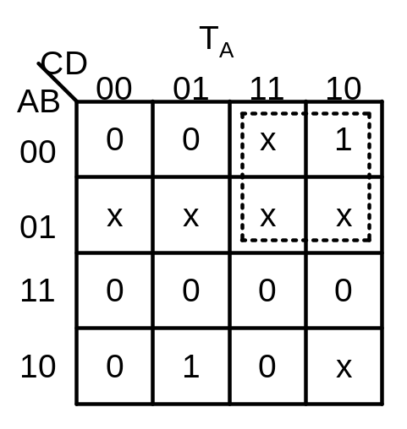

Using the derived expressions the combinational circuit can be synthesized.

Slide 11
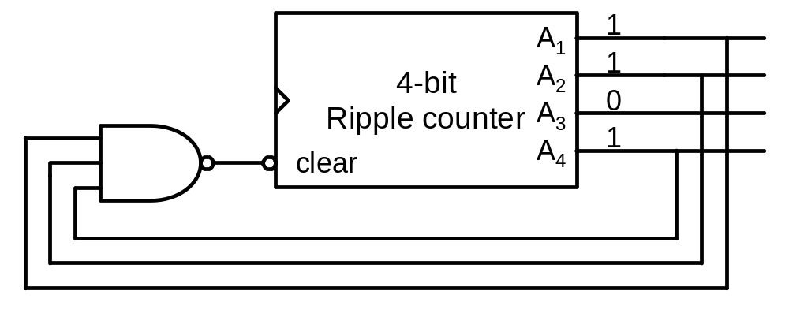
Q.6 Suppose a 4-bit ripple counter is available with a asynchronous reset input. Show how you can construct a counter which has the count sequence 0-1-2-3-4-5-6-7-8-9-10-11-12-0….

Slide 12
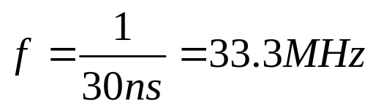
Q.7 A flip-flop has a 3ns delay from the time the clock edge occurs to the time the output is complemented. What is the maximum delay in a 10-bit RIPPLE counter that uses this type of flip-flop?
The worst case is when all 10 flip-flops are complemented. The maximum delay is 10 x 3ns = 30ns. The maximum frequency then will be:

Slide 13
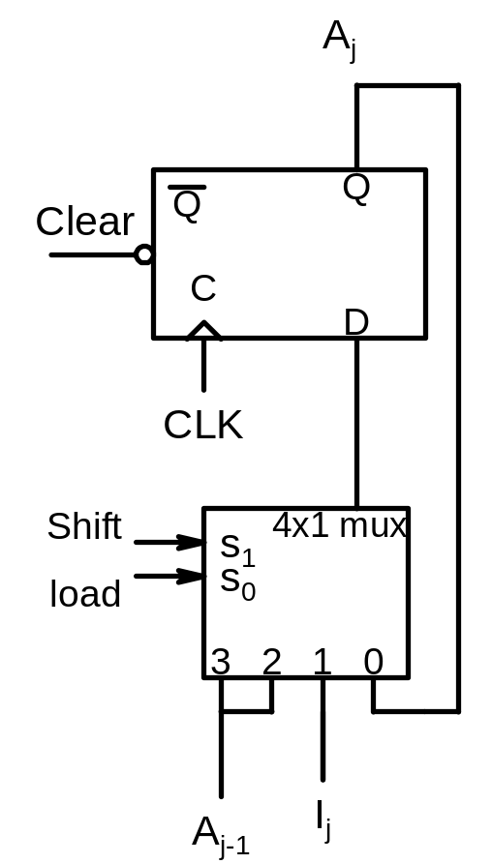
Q.8 Design a 4-bit shift register with parallel load using D FFs. There are 2 control inputs: shift and load. When shift = 1, the contents of the register are shifted by one position. New data are transferred into the register when load = 1 and shift = 0. If both control inputs are equal to 0, the contents of the register do not change
The register is made of 4 stages each of which has the structure shown below
For the first stage, A_{j-1} is the serial input
If a Mux is not available then a combinational circuit can be synthesized.
Shift Load
D_{j}
0 0
A_{j}
0 1
I_{j}
1 x
A_{j-1}

Slide 14
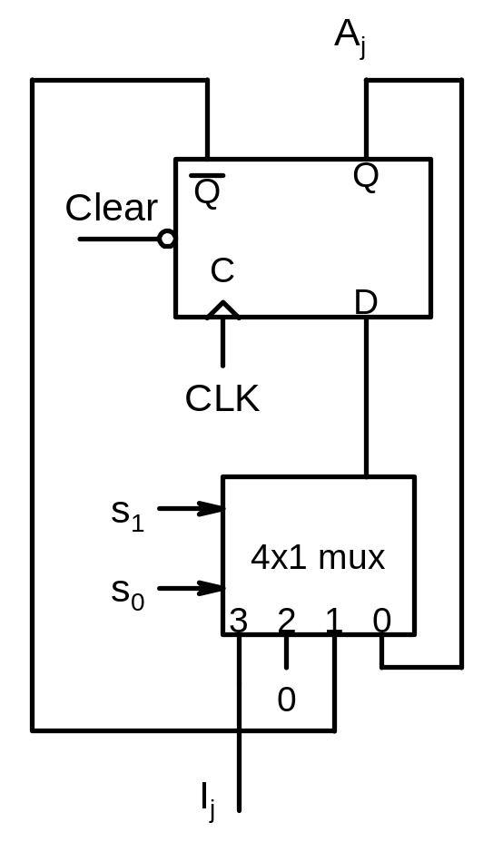
Q.6Design a 4-bit register with 4 D FFs and four 4-to-1 multiplexers with control inputs s1 and s2 such that when S1S2 = 00, there is no change in the register content; when 01 the outputs are complemented; when 10 the register is cleared to 0 synchronously and when 11 the parallel data is synchronously loaded
The register is made of 4 stages each of which has the structure shown below

